Slide 1


Slide 2
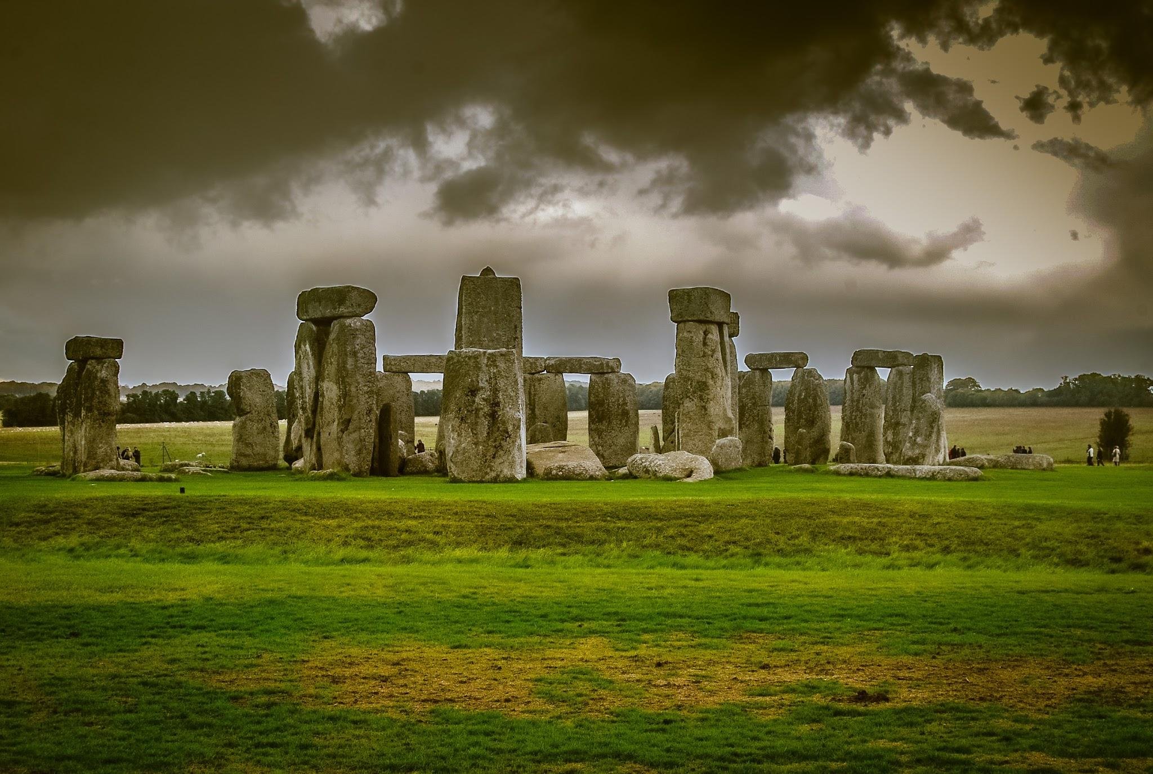
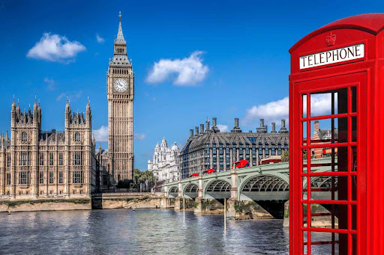
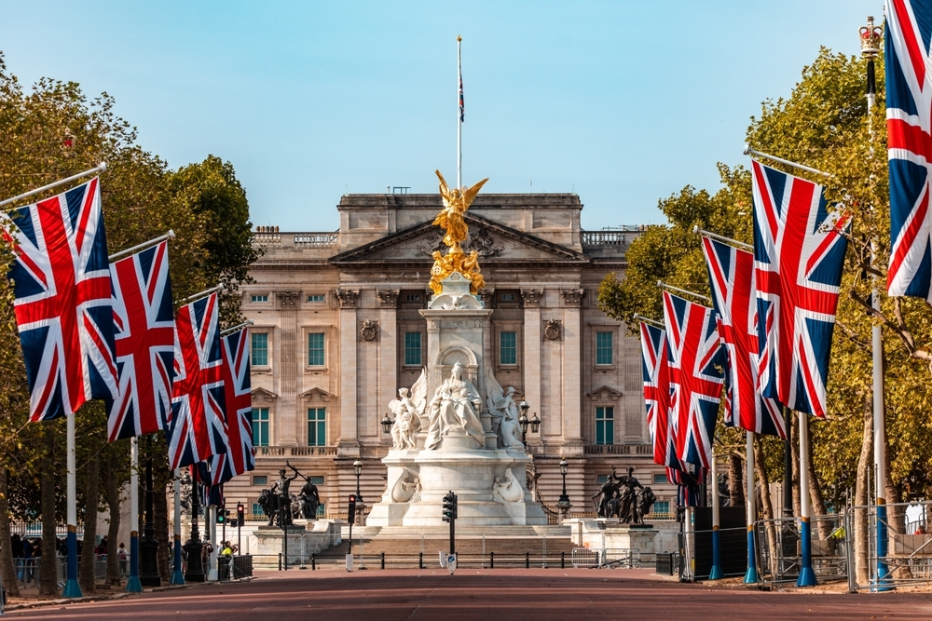
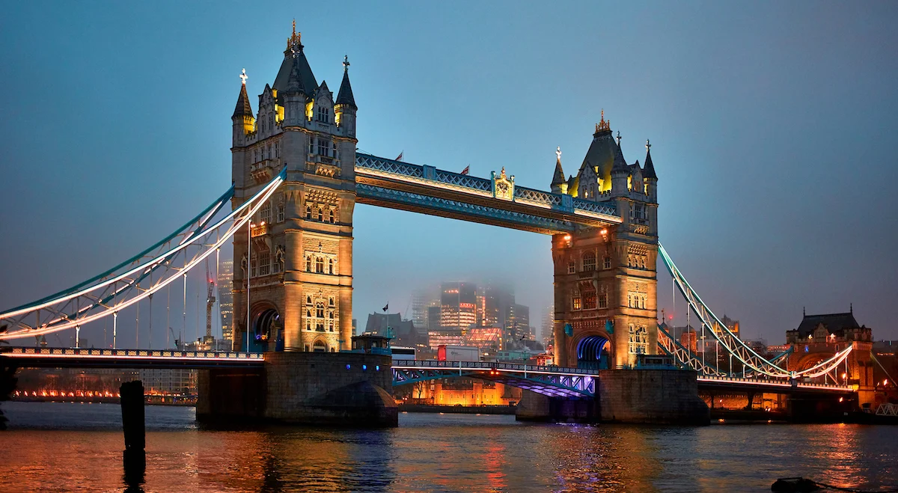
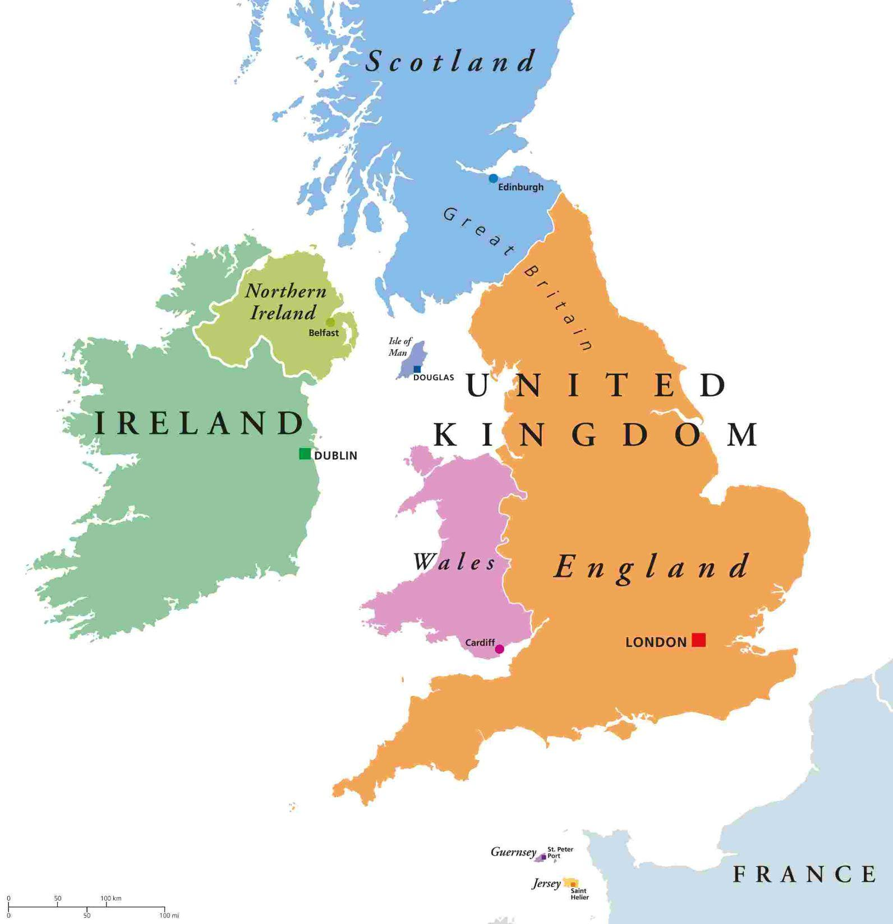
The Background And history of The United Kingdom
The United Kingdom is located in northwestern coast in Europe. The UK has 69 to 70 million people in thy country. The UK is a country that is multicultural. The United Kingdom became a country in 1801. But they also were in the medieval times in 1066.

Slide 3

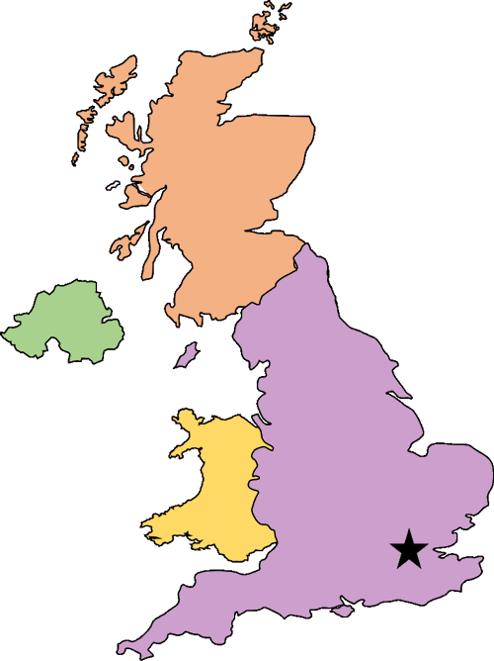










Sēo woruldlīce sprǣc on þǣm ānlǣhtan rīce
(“The worldly discussion in the united kingdom” Its old English)
The UK is having a huge problem with Immigration policies. The UK didn’t want people from Afghanistan, Cameroon, Myanmar, and Sudan, to buy tickets to go to the UK and ask to be refugees. So the UK had made a Visa brake. Which is like saying “No more planes that are going to the UK from those countries!”
I know. Hey! Remember when Mom (France) had so many arguments with dad, before we were born?
YEAH! They had that one argument for like 100 years!
GO BACK!!!!
Sheesh! Dad’s rude.
👉
👎

Slide 4
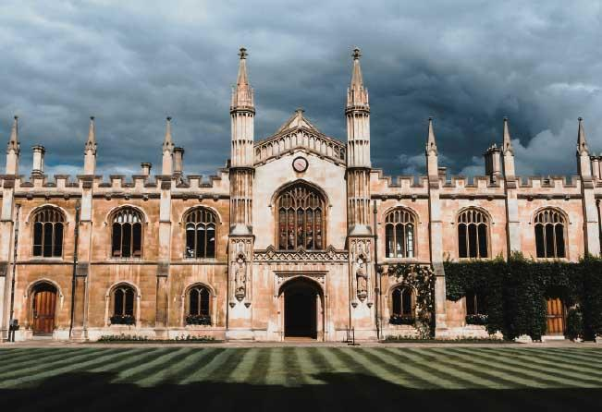

The Countries response. The VISA Brake.
The UK’s response was this thing called the “VISA Brake”. Let me tell ya how it is.
The UK would say no to give a student from those 4 countries a student VISA. For example: If you were a student in afghanistan, and you won a schoolscholarship to a British University, the UK would say no to that because of the VISA Break.
NO VISA, NO SCHOOL, NO COMING TO THE UK!!!!
Aww poor him. 😢
But I worked so hard. 😢
Gee! Mom is so much nicer!
🔒
🔑
📄
A+ on The Kankor Exam. The hardest exam in Afghanistan.

Slide 5
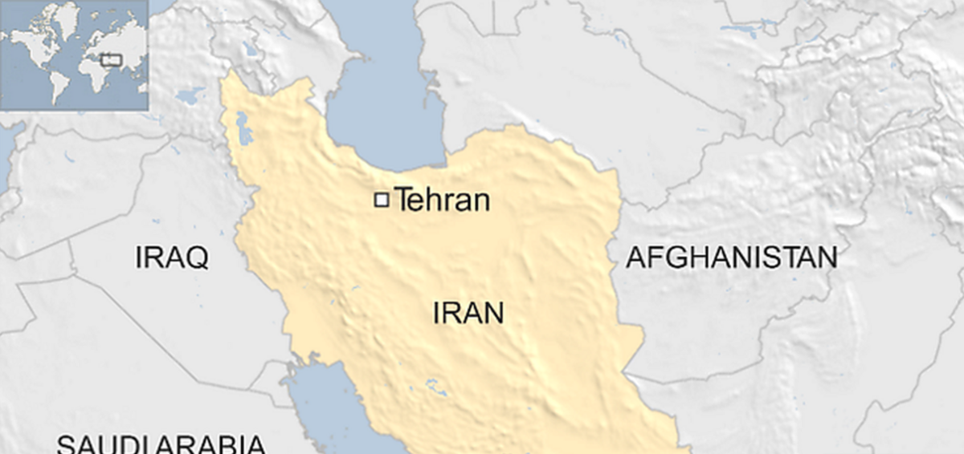

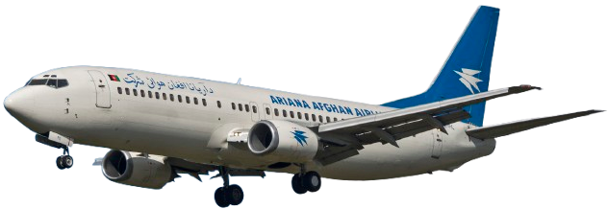
The Consequences.
The consequences are terrible. The people wanna flee out of those countries, because those countries are like war zones. They might even get caught in the Iran and USA war, like Afghanistan is just right next to Iran. Their dreams would end, because what if they wanted to get a job in UK. Like the example on the slide before.
Hey, can my plane passthrough without getting shot?
But my dad won’t let you go into his country!

Slide 6
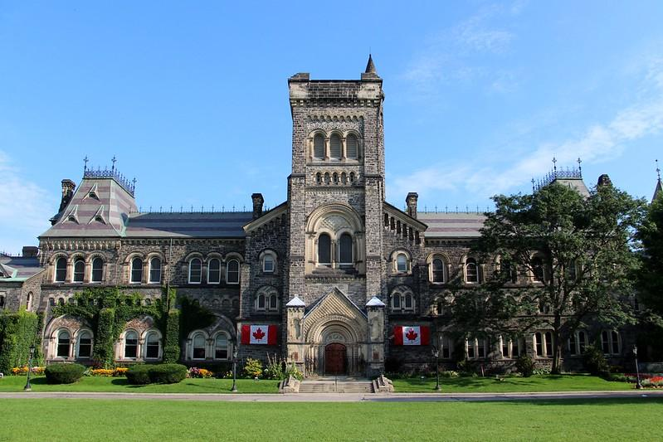

UK problem + Canada = Me telling you the comparison
Canada has the same problem, but Canada works differently than the UK. The UK, keeps its country locked, like 2 slideshows before. But Canada, keeps it unlocked, but still has some strict rules before they move on, like financial check. Canada also made them have time limits that makes it not so easy to become a refugee. But, Canada lets them in, but they have a one year time limit in Canada. Once it ends, they have to work with papers and then get sent back home.
Alright, you can come here, but you have one year here before you go back!
See Hon? Our son got its kindness from me, NOT you!
Whatever. At least my other son is on my side.
ALRIGHT!!! YOU ROCK CANADA!!!
🌸
🔓
🔑
👜

Slide 7



Why should Canadians care?
I think we should care. Because, I think people from those countries live in safe countries like the UK and Canada. When I looked up Afghanistan, I only saw military and wreckage. When I look up something like USA, I see beautiful landscapes and safe places. If people from those countries wanna live somewhere safe, then the UK and Canada should make it easy for them to live as refugees.
So cute!
My mom told me to be the nicest country in the whole wide world!
Well, PIZZA FOR YOU!!
Aww! How adorable!

Slide 8
A short story after this slide that I wanted to make.

Slide 9


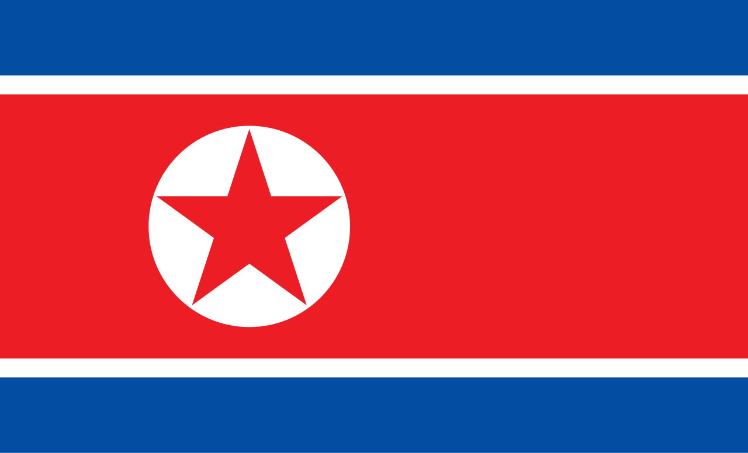




Alright, We are here to discuss if we should have nukes or not in our country.

Slide 10
Sorry that I’m late!!

Slide 11
Didn’t I tell you to stay with your brother?!
But I’m the most powerful country in the world!

Slide 12
Your 15! Your too young to discuss this. Now go stay with your brother, or no XBox for 2 weeks!
UGH! FINE!

Slide 13












=
Sigh…
Today, we will be descwussing, if soup is cerwheel!

